Slide 1
Audits, ADRs, & Documentation
Reduce Risk
Maureen Hedrick &
Jennifer Leatherbarrow RN BSN, RAC-CT, QCP
Richter Healthcare Consultants

Slide 2
Objectives
Increase awareness of skilled documentation guidelines
Clarify the differences in skilled and unskilled charting requirements
Take away tips and procedural concepts to assist with ensuring and monitoring proper documentation
Review processes to manage response to requests for documentation
Provide checklist to assist with internal auditing process

Slide 3
Audits & ADRs

Slide 4

ADRs, Audits & Documentation
What is an ADR?
  Audit Agencies
Who is asking?
Why are they asking?
What do they want?
  Focus Areas
Notes:
Additional Development Request
Issued through the Medicare Administrative Contractor – on behalf of the MAC for MMR or on behalf of an audit contractor (RA, SMRC or CERT) – additional letters mailed directly to facility – at the address that is on file with the 855 (provider enrollment form)
Check NPI registry to confirm the address is correct – contact the MAC if you need to correct an amended 855 will need to be completed (can be done online)
ADRs are issued to review documentation for specific issues as determined by CMS or other governing agencies of the Federal Gov – such as the OIG
All stems from the FALSE CLAIMS ACT
Since 1863 d/t Civil War suppliers
Revised 1986 – imposition of $5 - $11K fine PER FALSE CLAIM TIMES 3 and whistleblower protection
Revised 2009 – Fraud Enforcement & Recovery Act – prohibiting KNOWINGLY making a false claim, applying definition
Revised 2010 – Affordable Care Act – specific language regarding recovery of overpayments and timeline for provider return of monies
They want their money back

Slide 5
ADRs, Audits & Documentation
Office of the Inspector General (OIG)
Voluntary Compliance Mandate 1998
OIG Compliance Program Guides (CPGs)
OIG Work Plan 2016 – high therapy utilization identified
  The focus is on SNF documentation
Notes:
2015 OIG issued the Work Plan for 2016
Recently issued compendium indicates that the OIG considers the issue to be ongoing – work plan is specifically focusing on documentation and additional focus on the MACs abilities to follow CMS directives on improper payment recovery
2016 OIG Work Plan – ADD

Slide 6
ADRs, Audits & Documentation
Recovery Audit Program
  Medicare Prescription Drug, Improvement and Modernization Act of 2003
  Established in 2009 and fully implemented by 2010
  Annual Report to Congress required
  CMS manually reviews less than 0.3% of submitted claims annually
  Focus is returning to SNFs
Notes:
THREE YEAR LOOKBACK
If evidence of fraud is found then RA will refer to ZPIC (Zone Program Integrity Contractor) – they have a 10 YEAR lookback and will come onsite.
The concerns (RUG scores – therapy) have prompted CMS to refer the issue to the Recovery Auditor contractors for further investigation
Keep in mind the RA has a 3 year lookback
CMS Memo –Mar 9, 2016
Referencing the Report on Skilled Nursing Facility utilization and payment data
The report is collated as per the mandate for greater transparency
“CMS strives to ensure that patient need, rather than payment system incentives are driving the provision of services”
Refer to National and Local Coverage Determinations and the Medicare Integrity Program for guidance

Slide 7
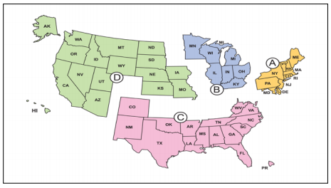
Recovery Auditors
Region A:
Performant Recovery
Region D:
HealthDataInsights, Inc.
Region B:
CGI Federal, Inc.
Region C:
Connolly, Inc.

Slide 8
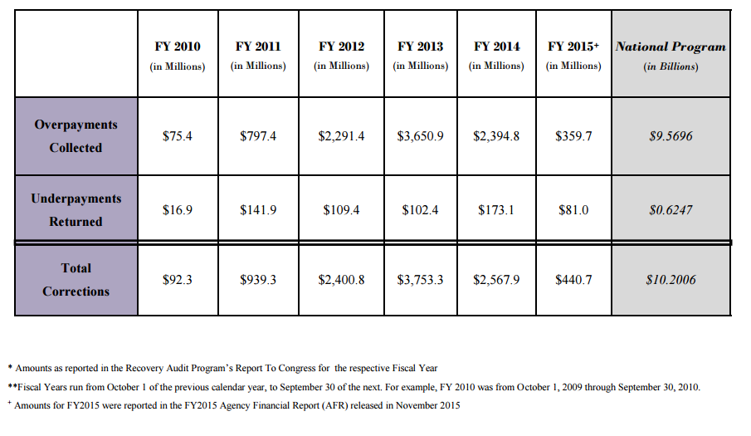
Notes:
Per OIG – CMS has reported an improper payment rate of 12.7% for FFS Med A/B = $45.8 BILLION in improper payments in FY2014
Notice that there was a decrease in recoupment through 2014 and then heightened activity by the RA’s in 2015 mainly related to Manual Medical Reviews for therapy exceeding the caps

Slide 9
Documentation

Slide 10
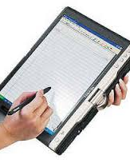
Documentation
Goal of Documentation
  Regulatory compliance
  Continuity of Care
  Payer requirements
Notes:
Goal of documentation is to substantiate daily skilled care
Required for Medicare reimbursement
Establish Case Mix Index for Medicaid
Record treatments, therapies and resident response
Communicate between disciplines
facilitate continuity of care
Continuity of Care
Care planning
Patient centric care
Federal Regulations F 514
In order to obtain and maintain Medicare certification:
The facility must maintain clinical records on each resident in accordance with accepted professional standards and practices that are
Complete
Accurately documented
Readily accessible
Systematically organized

Slide 11

Documentation
Clinical Reports to assist with monitoring CMI and RUG Utilization
  Case Mix – Detail
  RUGs Summary

Slide 12
When you document effectively, your patient’s medical record reflects your professionalism
Seeber-Combs, 2006, p. 1

Slide 13

Documentation
Acceptable nursing practices
  Chronological order
  No advanced charting
  Document only what qualified to do
Clinical decision making
  Objectivity
  Within acceptable practice
Notes:
General Documentation Tips
a. Communication of resident’s needs and care received
b. Demonstrate clinical decision making
c. Demonstrate need for skilled level of care
d. Documentation should support appropriately billed services
e. Document on all clinical issues
f. Document on Rehab/treatments
g. Document on ADLs/other functional areas
h. Document on Cognition/mood
i. Document on changes in condition/new orders
j. Be sure that your notes reflect the individual resident

Slide 14
Documentation
Skilled care
  Reasons for services
  Clinical issues
  Rehab/ treatments
  Support of billable items
Define Skilled vs Unskilled Documentation

Slide 15
Documentation
Common documentation issues that lead to denial/ RUG reduction
  Physician orders vague or incomplete
  Does not reflect progress (medical necessity)
  Inconsistencies between MDS and nursing, therapy notes
  Lack of objective, measurable and functional goals
Notes:
V. Common Documentation issues that lead to denial /RUG reduction:
a. Physician orders too vague
b. Notes do not reflect progress (medical necessity, “reasonable & necessary”)
c. MDS, Therapy & Nursing notes inconsistent
d. In an unpredictable manner
e. Lack of objective, measurable and functional goals
f. MDS inconsistencies among RUG items

Slide 16

Documentation
Missing Entries Report
  Care Plans
  Assessments
  Diagnosis
Integrations
  Pharmacy
  Therapy
  Diagnostic: Lab & X-ray

Slide 17
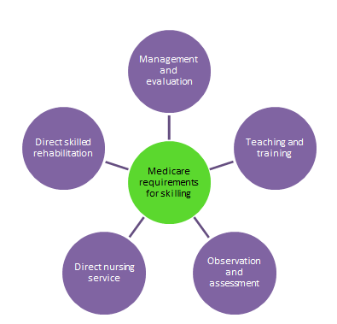
Documentation
Observation and assessment
Management and evaluation
Teaching and training
Direct nursing service
Direct skilled rehabilitation
Notes:
5 broad categories of skilled care
a. Observation and assessment- Observation and assessment constitute skilled services when the skills of a technical or professional person are required to identify and evaluate the patient’s need for modification of treatment or for additional medical procedures until his or her condition is stabilized.
b. Management and evaluation- The development, management, and evaluation of a patient care plan based on the physician’s orders constitute skilled services when, because of the patient’s physical or mental condition, those activities require the
involvement of technical or professional personnel in order to meet the patient’s
needs, promote recovery, and ensure medical safety.
c. Teaching and training- Patient education services are skilled services if the use of technical or professional personnel is necessary to teach a patient self‐maintenance
Examples of skilled teaching activities:
i. Self‐administration of injectable medications
ii. A newly diagnosed diabetic (insulin, diet, foot‐care)
iii. Self‐administration of nebs/inhalers
iv. Gait training/prosthesis care
v. Care of a recent colostomy/ ileostomy
vi. Care of braces, splints, orthotics
d. Central or peripheral intravenous therapy
ii. Pressure ulcer management
iii. Tube feeding (meeting requirements)
iv. Nasopharyngeal and tracheostomy suctioning
v. Wound management

Slide 18

Documentation
PointClickCare Compliance Analytics
  Quality Programs Management
  Root Cause Analysis
  Guided Workflows
Notes:
Analytics module helps you set goals for QM and KPI as well as managing the work flow for PIP

Slide 19
Technical Requirements for SNF Care & Documentation Guidelines

Slide 20
Technical Requirements for SNF Care
Physician certification of the need for daily skilled care given by, or under the direct supervision of skilled nursing or therapy staff
Medical condition is either a hospital related medical condition or a condition that began in a SNF for a hospital related medical condition
Notes:
Medicare eligibility requirements
a. A medically necessary three-day hospital stay must have occurred. This does not include emergency room hours; rather, the clock starts ticking at the time the patient is admitted to an acute care bed. The hospital discharge must have occurred on or after the first day of the month in which the individual attains age 65 or becomes entitled to health insurance benefits under the disability or chronic renal disease provisions of the Medicare law. The three consecutive calendar days’ requirement can be met by stays totaling three consecutive days in one or more hospitals. In determining whether the requirement has been met, the day of admission, but not the day of discharge, is counted as a hospital inpatient day.
The patient must receive Part A care within 30 days of the qualifying hospital stay. Customarily, this is not a problem unless the patient is returning after being discharged home or is being readmitted from another setting. In such cases, it is very important to determine the reason for the return service, how it relates to the original qualifying stay, and whether a Medical Predictability Order was written.
Medicare skilled service requirements
i. Daily Basis
ii. Rehabilitation—PT/OT/ST at least 5 days a week
iii. Skilled Nursing—7 days a week
iv. Restorative Nursing—at least 6 days a week

Slide 21
Skilled Nursing Facility Coverage
Medicare covered services in the SNF include, but aren't limited to:
Semi-private room
Meals
Skilled nursing care
Therapy: Physical, Occupational and Speech Language Pathology Services
Medical social services
Medications (with some exclusions)
Medical supplies and equipment used in the facility
Ambulance Transportation (when other transport is not available or endangers health of patient)
Dietary Counseling

Slide 22
Medicare Documentation Guidelines
National &/or Local Coverage Determinations
  NCD’s made through an evidenced-based process, with opportunities for public participation. In some cases supplemented by the Medicare Evidence Development & Coverage Advisory Committee (MEDCAC)
  In the absence of a NCD, services may be covered at the discretion of the Medicare contractors (MACs) based on a Local Coverage Determination (LCD)
Notes:
Medicare eligibility requirements
A medically necessary three-day hospital stay must have occurred – be aware of Observation days - renewed focus from RA for observation day use
The patient must receive Part A care within 30 days of the qualifying hospital stay.
Skilled Service Requirements
Daily Basis
Rehabilitation—PT/OT/ST at least 5 days a week
Skilled Nursing—7 days a week
Restorative Nursing—at least 6 days a week
NCD/ LCD – issued by CMS/ MAC (in the lack of an LCD, refer to the National) – issues express directives re documentation and specific coding requirements

Slide 23
ADR & Audit Response

Slide 24

Managing the Response
Purpose
Process
Accountability
Tracking
Outcomes
Notes:
Purpose – to ensure a full and proper response – must have Policy & Procedure in place to address the process:
What is the response process – CBO/ Medical Records/ Clinician/ Therapy
Who will manage the response – and HOW
Who will track the response – and HOW
ADRS or Recoupment Requests
ADRs issued electronically – can be monitored in eSolutions or Ability EASE, and by letter – know where the letters are going (855) and what they look like. Examples on the
RA websites, CMS website for SMRC and CERT, etc.
Automatic review recoupment will be noted on the remittance – Code N432 (or N469 if related to CERT)
P&P and compliance plan should be integrated into job descriptions and performance evaluations
Track ADRs and reviews – only 1 per claim
Utilize tracking tool to track outcomes so that you can better evaluate educational needs and PROVIDE EDUCATION

Slide 25

Preparation
Diagnoses Management
Signed Physician Orders
Nursing Documentation
Certification/ Re-certification
MDS/ Care Plan
Notes:
Diagnosis management- When the resident has been added to the therapy caseload, the therapist will have medical and therapy diagnosis codes on the evaluation. These diagnoses must then be supported in the medical record. It is therefore imperative that the diagnoses are added to the resident chart. Also worth mention is that the diagnosis must match throughout the residnet chart. This means that the diagnosis codes should be identical in the resident diagnosis section of the chart, in the therapy section of the chart, and on the UB-04.
Signed physician orders- Another key component to successful ADR’s is ensuring that you have signed orders for therapy. Often times I will see that a resident has an order for “PT/OT/ST eval and treat”. This order on its own will not be sufficient. If a therapy discipline wants to continue to treat a residnet they need to write an order for the specific discipline. This order should give the specific reason that they need therapy, such as gait imbalance, the number of times per week, as well as the duration to be seen.
Nursing documentation- The documentation in the nurses’ notes should continue at a minimum daily for the entire duration of the therapy treatment. This documentation will further substantiate the need for continued therapy. Supporting documentation- The first step for preparation is to ensure that there is supporting documentation in the resident chart or EHR for a minimum of 3 days prior to therapy adding the resident to their caseload. Documentation should include direct staff observations of a decline or improvement. This will be the basis for reason that therapy will pick up the resident.
Certs & Recerts - Certification and subsequent Re-certifications are a required part of your documentation process. If your Certs/Recerts are incomplete or untimely, your ADR will most certainly be denied. I frequently see incomplete certs that do not contain the specific therapy information required. Another common mistake is that the physician signs the cert form and the MDS nurse will date it. The regulation is very clear. The physician must sign and date the certs and recerts.
Care plan- Ensure that the plan of care for the resident addresses the condition for which therapy is treating. The therapy plan of care is not enough. You will need to update the nursing plan of care to reflect the current need for therapy treatment also. The nursing plan of care should include decline/ improvement in ADL’s, increased/decreased need for staff assistance, associated diagnoses, and any other resident specific information related to the need for therapy.

Slide 26
Preparation
Measure current practice
Compare results of practice to set standards
Reflect, plan, implement change
Evaluate
Set new Standards
Notes:
Measure current practice- against thresholds at a state or federal level
Set new standards- set standards based on current best practice for that specific item
Compare results of practice to set standards -how well do you compare
Reflect, plan implement change- plan and implement changes to improve
Evaluate- how well did you do with the new goal that were set
Then go back to the measure of current practice.

Slide 27

Self Audit & Evaluation
Triple Check
  Pre-submission
  Role of the Business Office
Internal Audit
  Post payment
  Sample based on volume
QAPI
Education
Notes:
Triple Check
Utilize a Checklist
Role of the business office – manage the process so that it is completed BEFORE billing, get everyone to the table and DOCUMENT the meeting
Think like an auditor – be objective
Post payment audits
10 % of claim volume
Charge to chart – to support all service items on the claims as well as appropriate coding
Certifications
MDS
ARD/ RUG level
Diagnosis
Track the outcomes for QA and Education…..
QAPI
Education

Slide 28
Self Audit & Evaluation
Triple Check Documents
  Trial Claims
  Diagnosis Sheets
  MDS Billing Calendar
  Detailed Monthly Census
Post Payment Review
  Medicare Billing Log
  Assessment Rate Reconciliation
Notes:
Business office/ finance dept can bring various reports to the meetings – clinicians should bring the medical records

Slide 29
Conclusion

Slide 30
Objectives
Increased awareness of skilled documentation guidelines and clarified the differences in skilled and unskilled charting requirements
Gained tips and procedural concepts to assist with ensuring and monitoring proper documentation
Reviewed processes to manage response to requests for documentation
Provided checklist to assist with internal auditing process
Notes:
XVIII. Conclusion/Wrap up
a. Good documentation demonstrates the resident’s ongoing needs as well as the care provided
b. Keep the 5 categories of skilled care in mind
c. Ensure that as much information as possible is captured in the documentation

Slide 31

Questions?
Jennifer Leatherbarrow, RN BSN, RAC-CT, QCP
Clinical Consultant
Email: Jennifer.Leatherbarrow@richterhc.com
Maureen Hedrick
Director of Consulting Services
Email: Maureen.Hedrick@richterhc.com
Phone: (216) 593.7140
Toll Free: 1.866.806.0799
Connect: LinkedIn and Facebook
Twitter: @RichterHC
Web: www.richterhc.com

